Slide 1
Adding shine to Shiny improving the look of your UI
Jacqueline Nolis
Principal Data Scientist, Nolis, LLC
@skyetetra

Slide 2
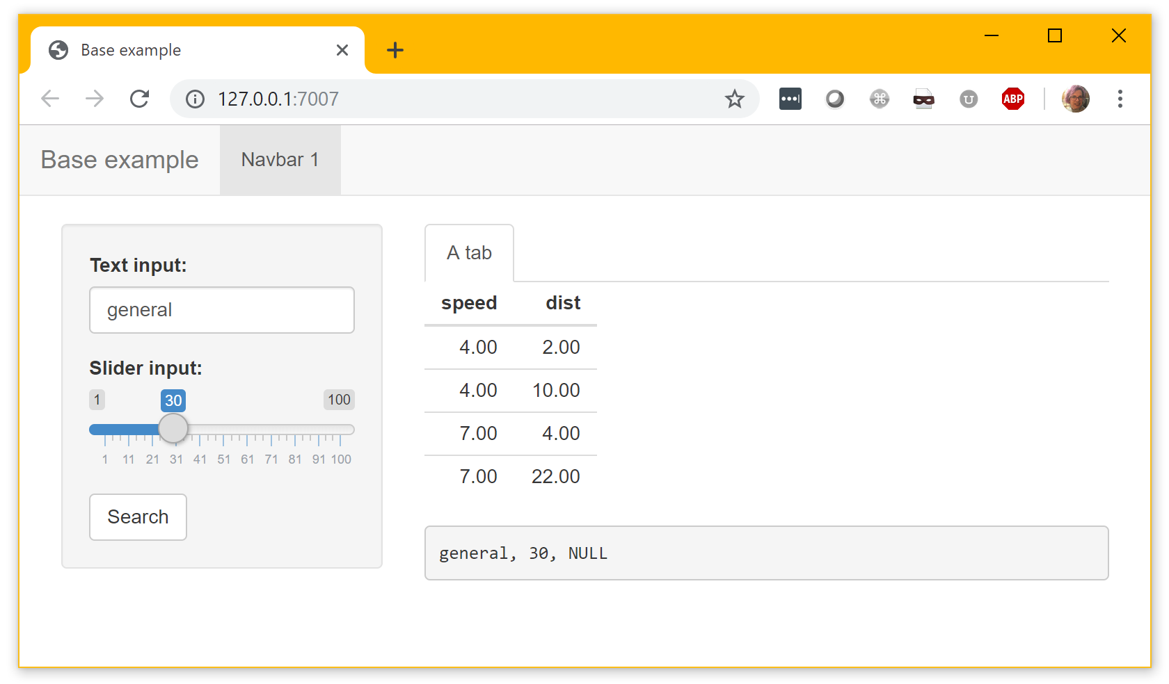
Shiny: interactive R GUIs
(Also with a boring default look)

Slide 3
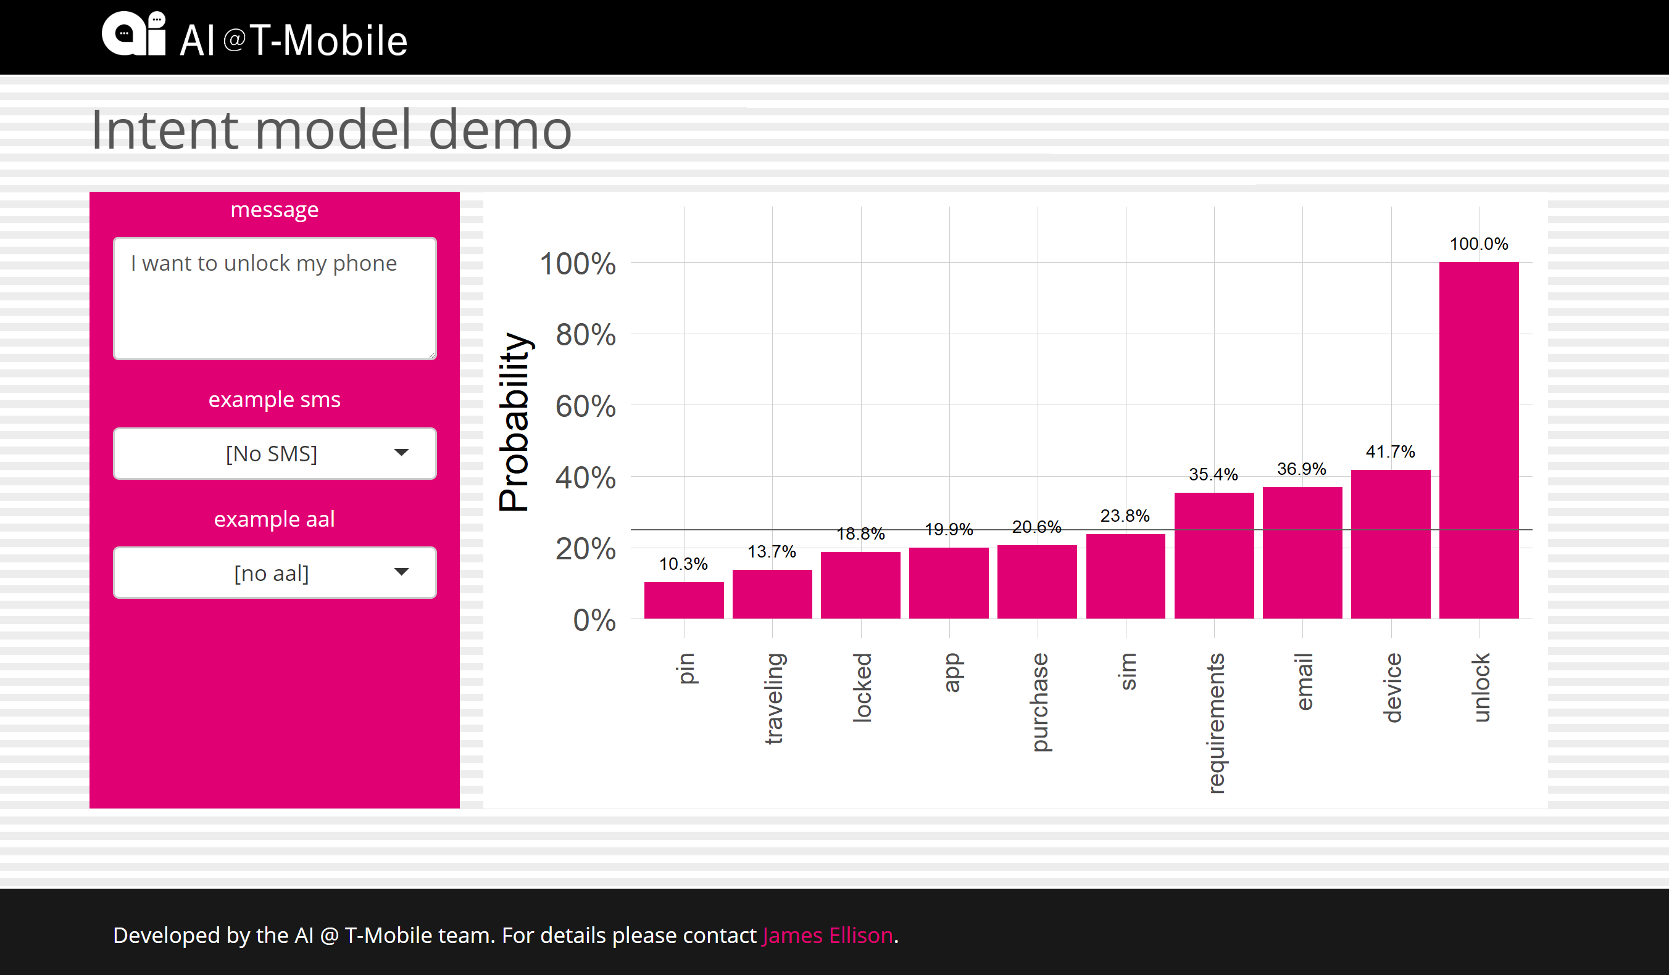
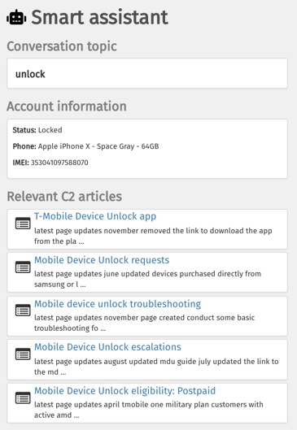
Appearance matters!
Professionalism = Credibility
Realistic prototypes

Slide 4

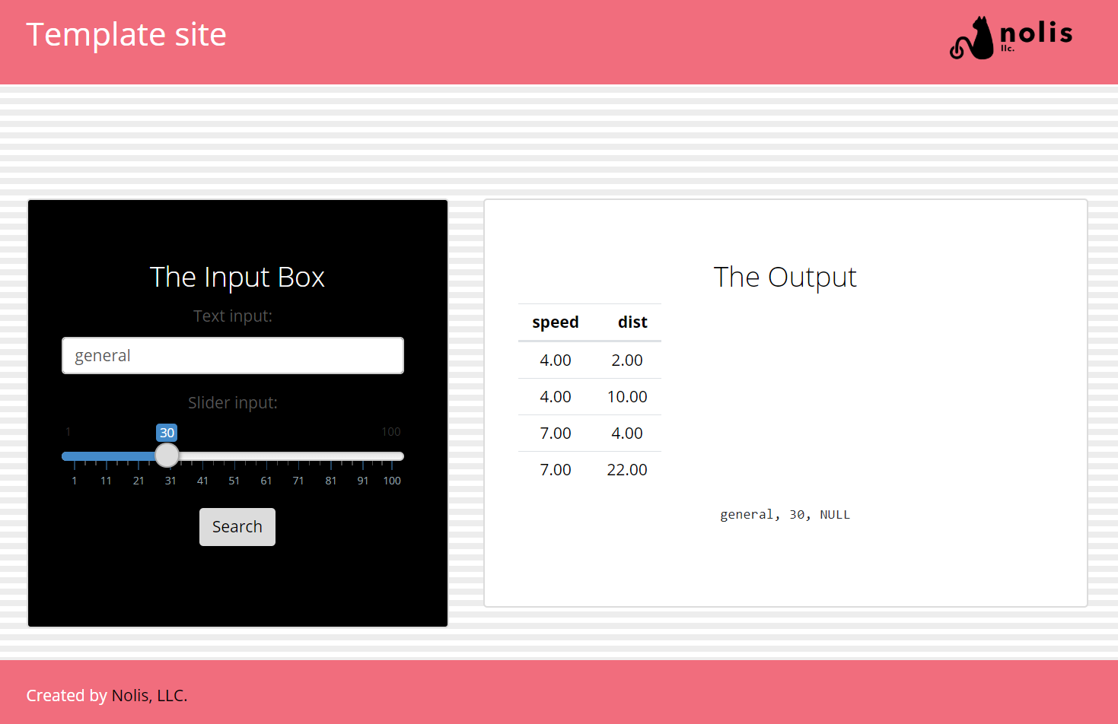
You can do this too!

Slide 5
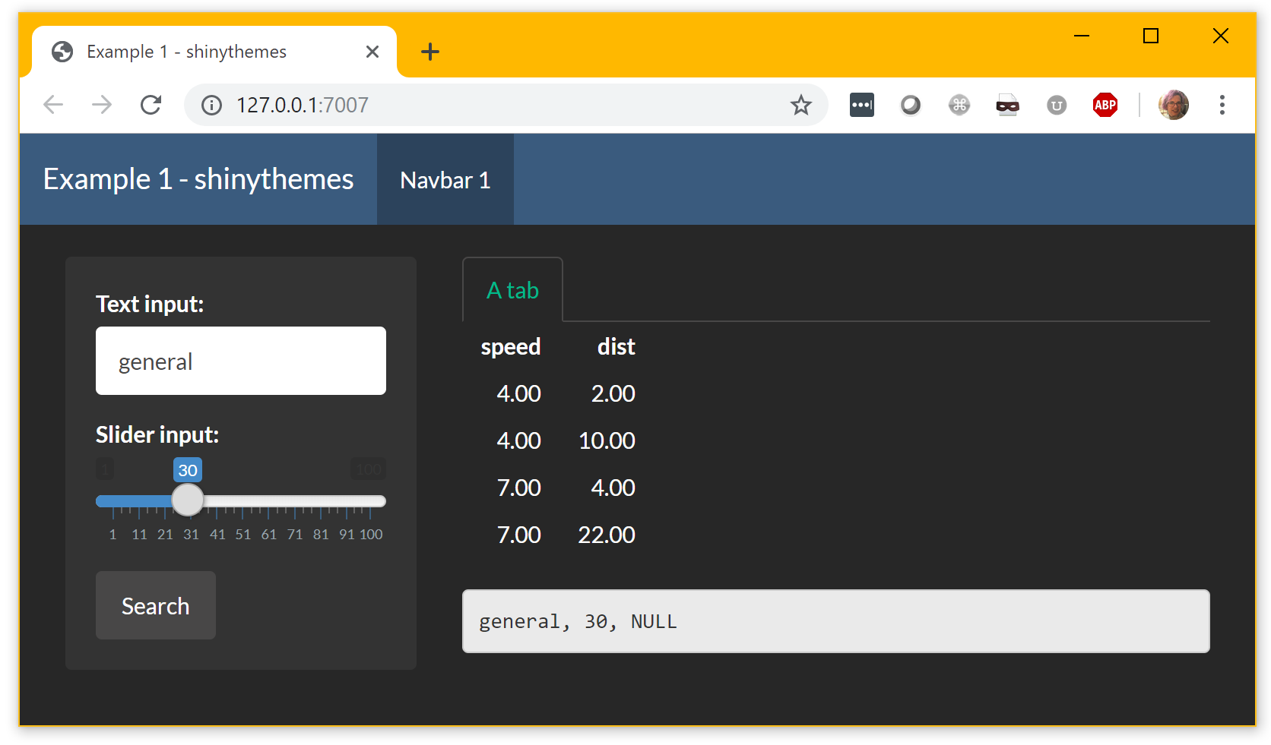
Quick fix: shinythemes
theme=shinythemes::shinytheme("darkly")

Slide 6
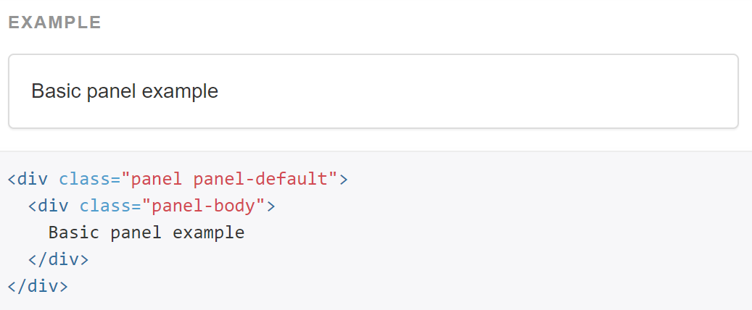
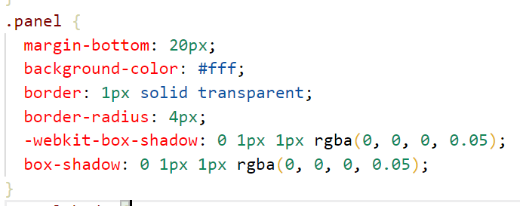
Dive into web dev: HTML + CSS
Shiny apps are websites
Basic web development:
HTML - content
CSS - style
Bootstrap: a good standard
Shiny uses Bootstrap 3
What you see
HTML
CSS

Slide 7
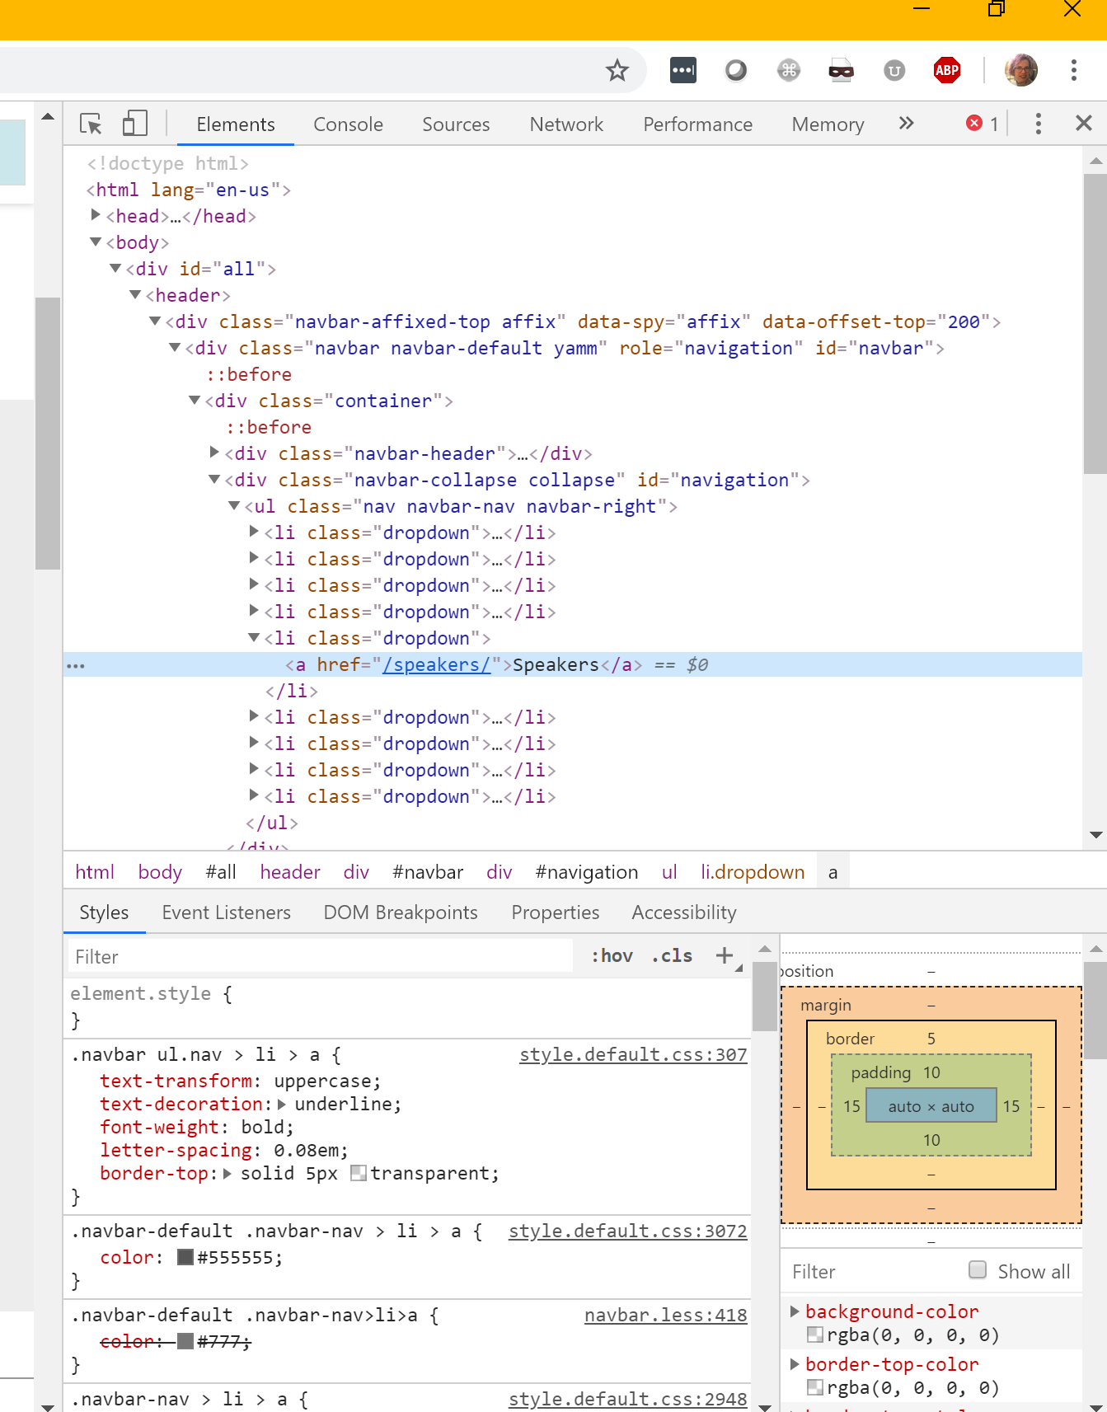
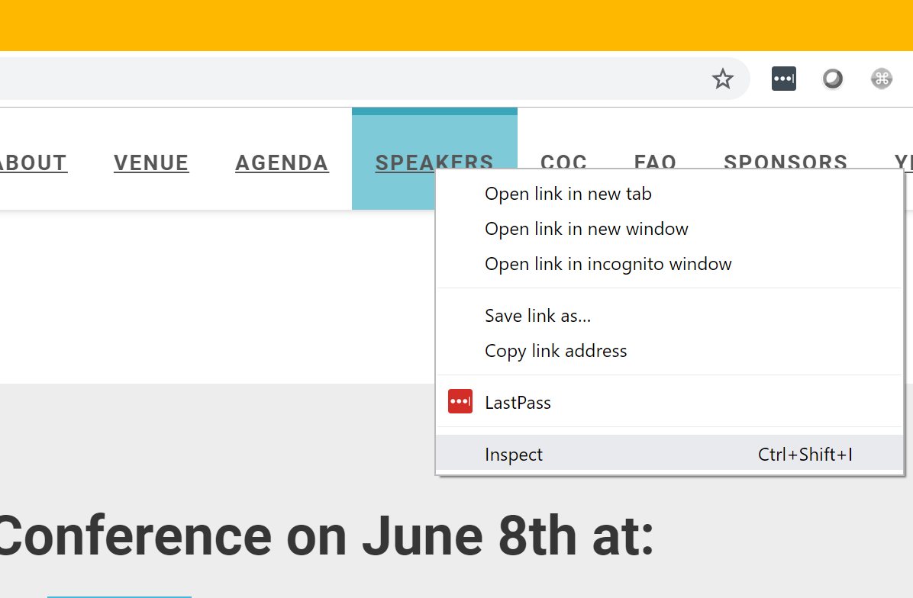
The magic is all around you
Chrome > (right click) > inspect

Slide 8
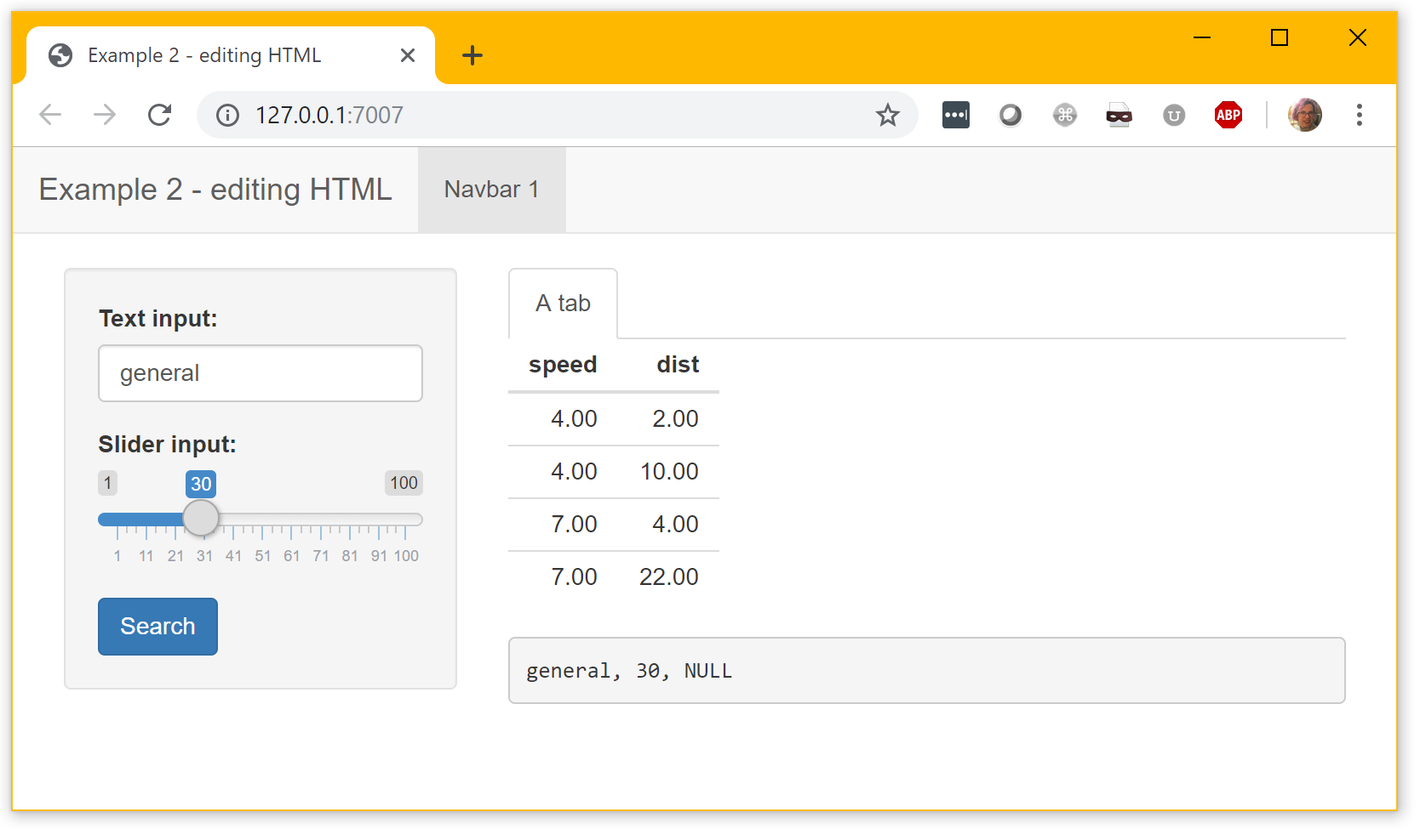
Edit R code to change HTML
actionButton("action", "Search", class="btn-primary")
default
with btn-primary

Slide 9
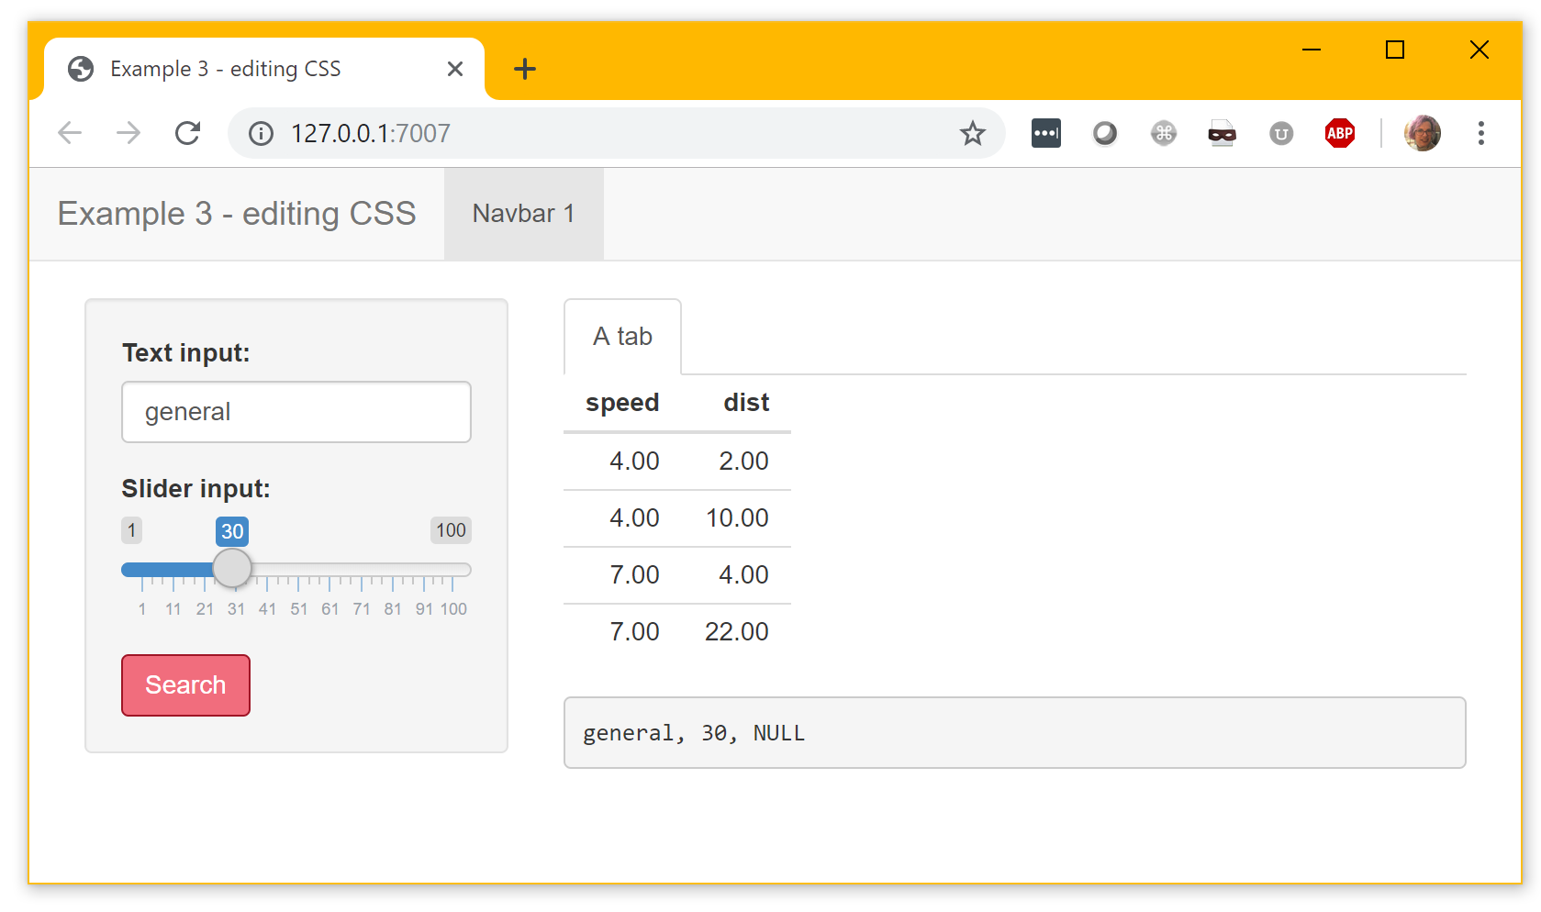
Edit the css
www/site.css
.btn-primary {
background-color: #F26D7E;
border-color: #A10E21;
}
app.R
header =
tags$head(
tags$link(rel = "stylesheet",
type = "text/css",
href = "site.css"))

Slide 10
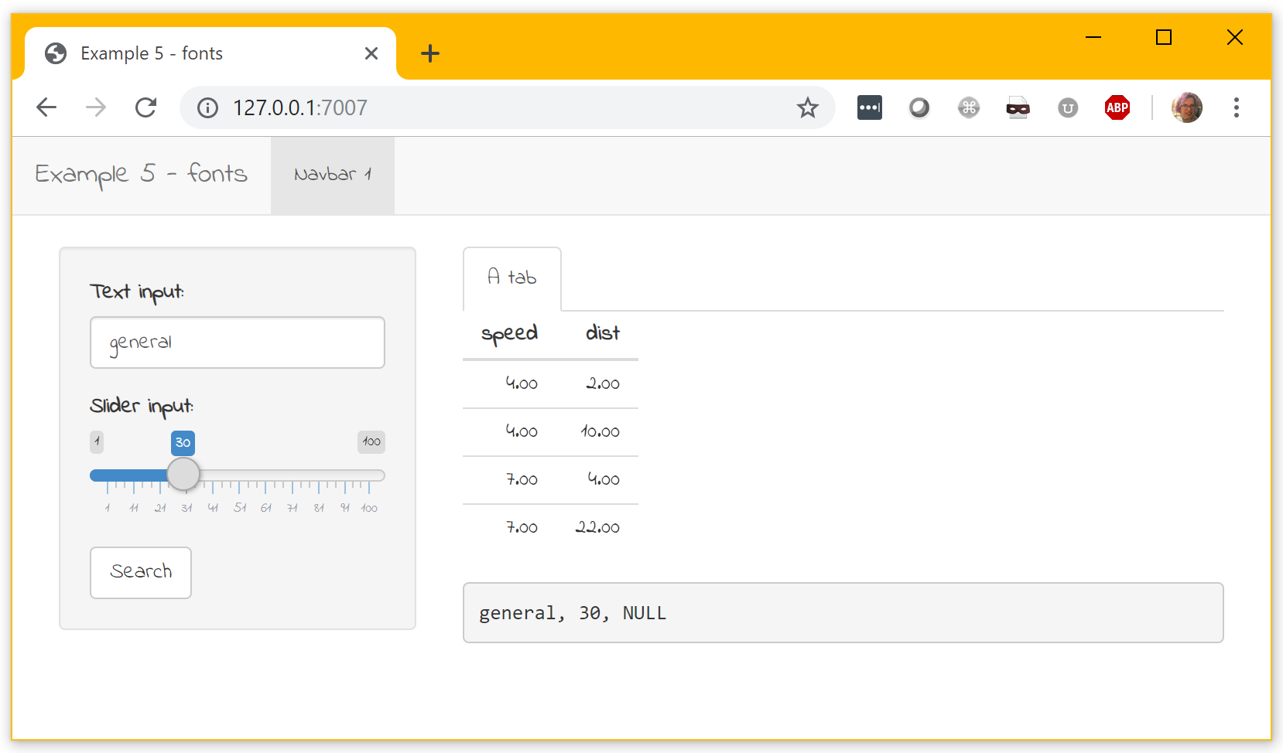
Change the font with Google fonts
app.R
header =
tags$head(
tags$link(rel = "stylesheet", type = "text/css",
href = "https://fonts.googleapis.com/css?family=Indie+Flower"),
tags$link(rel = "stylesheet", type = "text/css",
href = "site.css"))
www/site.css
body{
font-family:Indie Flower;
}

Slide 11
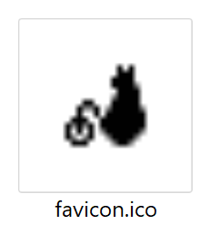
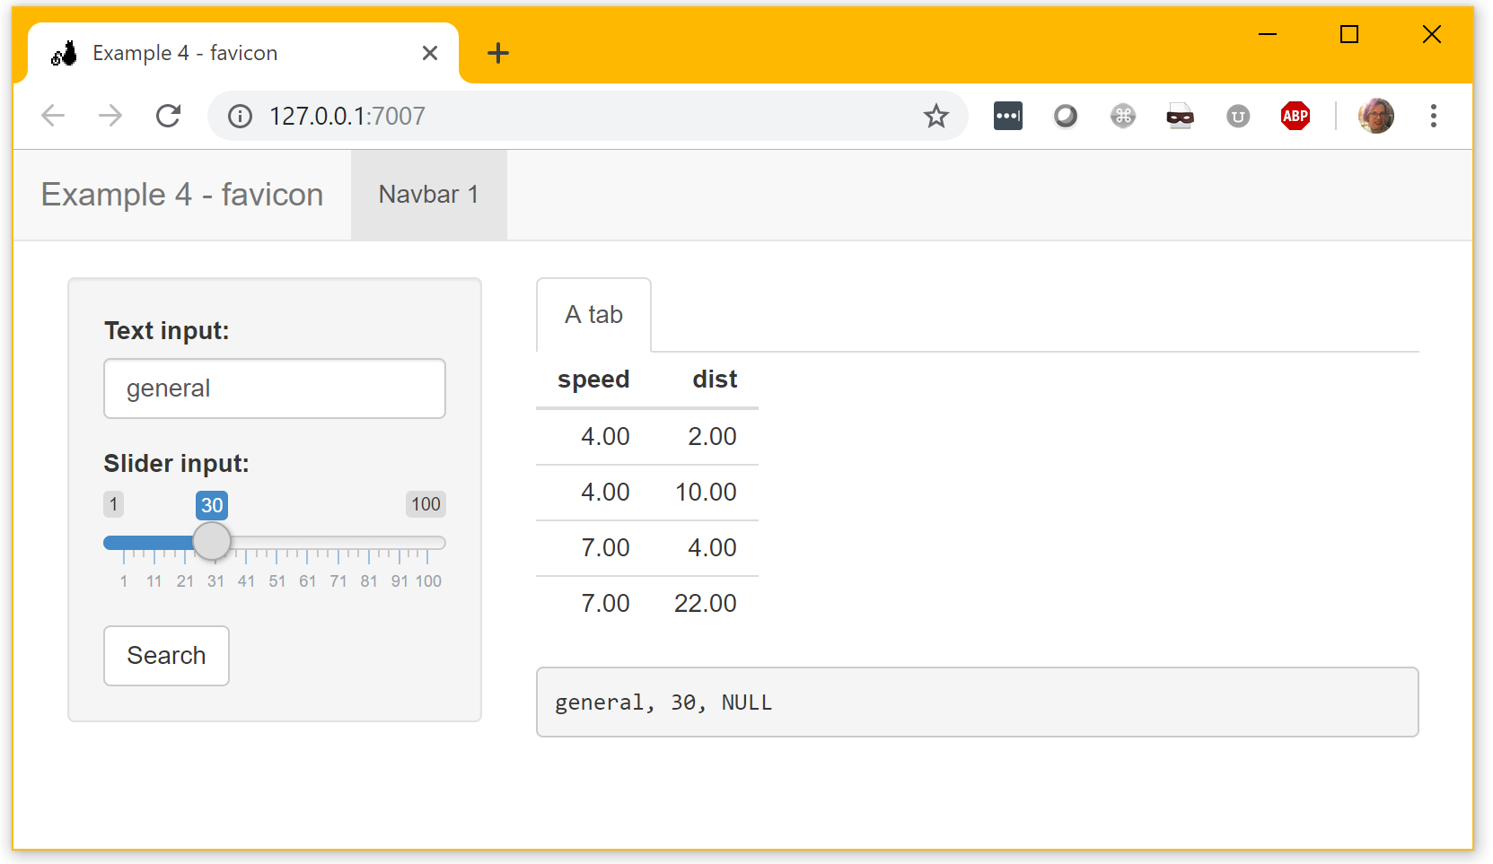
Even update the favicon!
header = tags$head(tags$link(rel="shortcut icon", href="favicon.ico"))

Slide 12
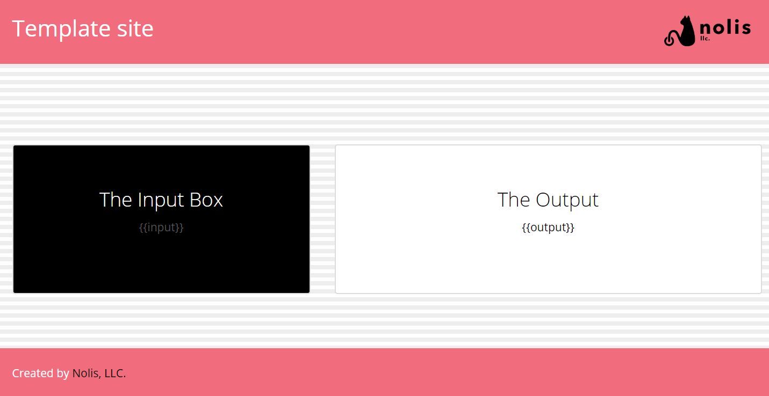
Embed shiny in existing site
template.html

Slide 13
Embed shiny in existing site
htmlTemplate("template.html“)

Slide 14
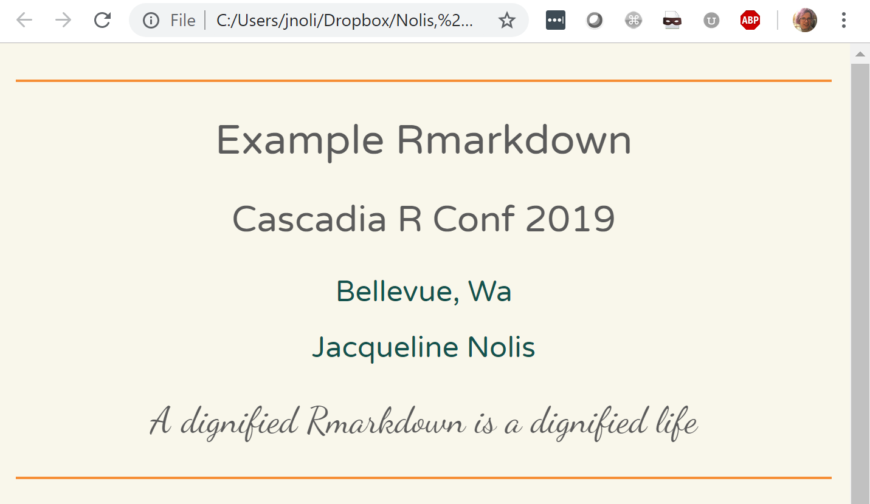
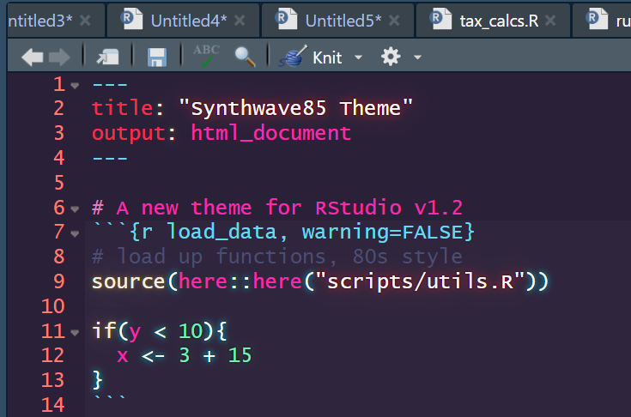
Bonus: works for Rmarkdown and RStudio themes too!
github.com/jnolis/synthwave85

Slide 15


Slide 16
Thank you!
Jacqueline Nolis
@skyetetra
github.com/jnolis
nolisllc.com

